Slide 1
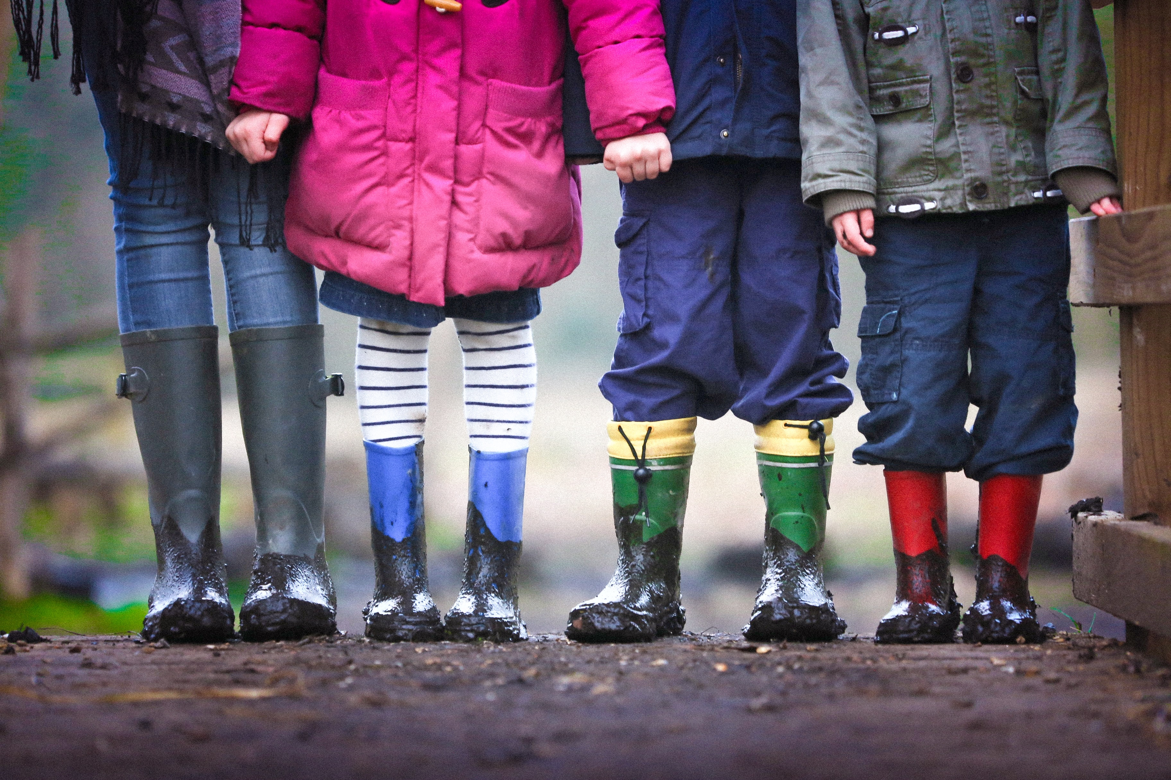

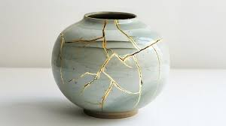
FOSTERING SUNDAY 2026
SHALOM:
Bringing Wholeness

Slide 2
The Art of Kintsugi

Slide 3
But we have this treasure in jars of clay to show that this all-surpassing power is from God and not from us.
2 Corinthians 4:7

Slide 4
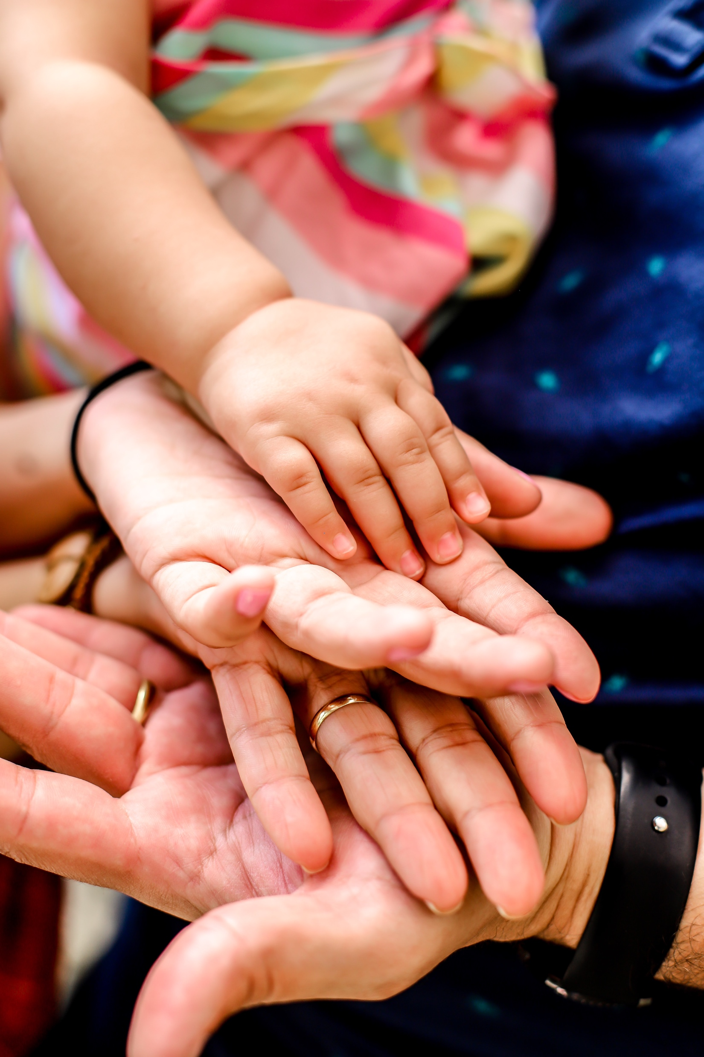
SHALOM A wholeness that brings life, peace and completeness to our whole selves: mind, body and soul. SHALOM brings wholeness to our communities, systems and our world.

Slide 5
Current Situation: Over 3500 children in care across Nottingham. Nottinghamshire and Derby Massive shortage of foster carers nationally and locally More children being placed in residential children’s homes than ever before

Slide 6
That is why, for Christ’s sake, I delight in weaknesses... For when I am weak, then I am strong. 2 Corinthians 12:10

Slide 7
INFORMATION EVENINGS
Wednesday 3 June – online
Monday 8 June – The Kings Church, Arnold

Slide 8
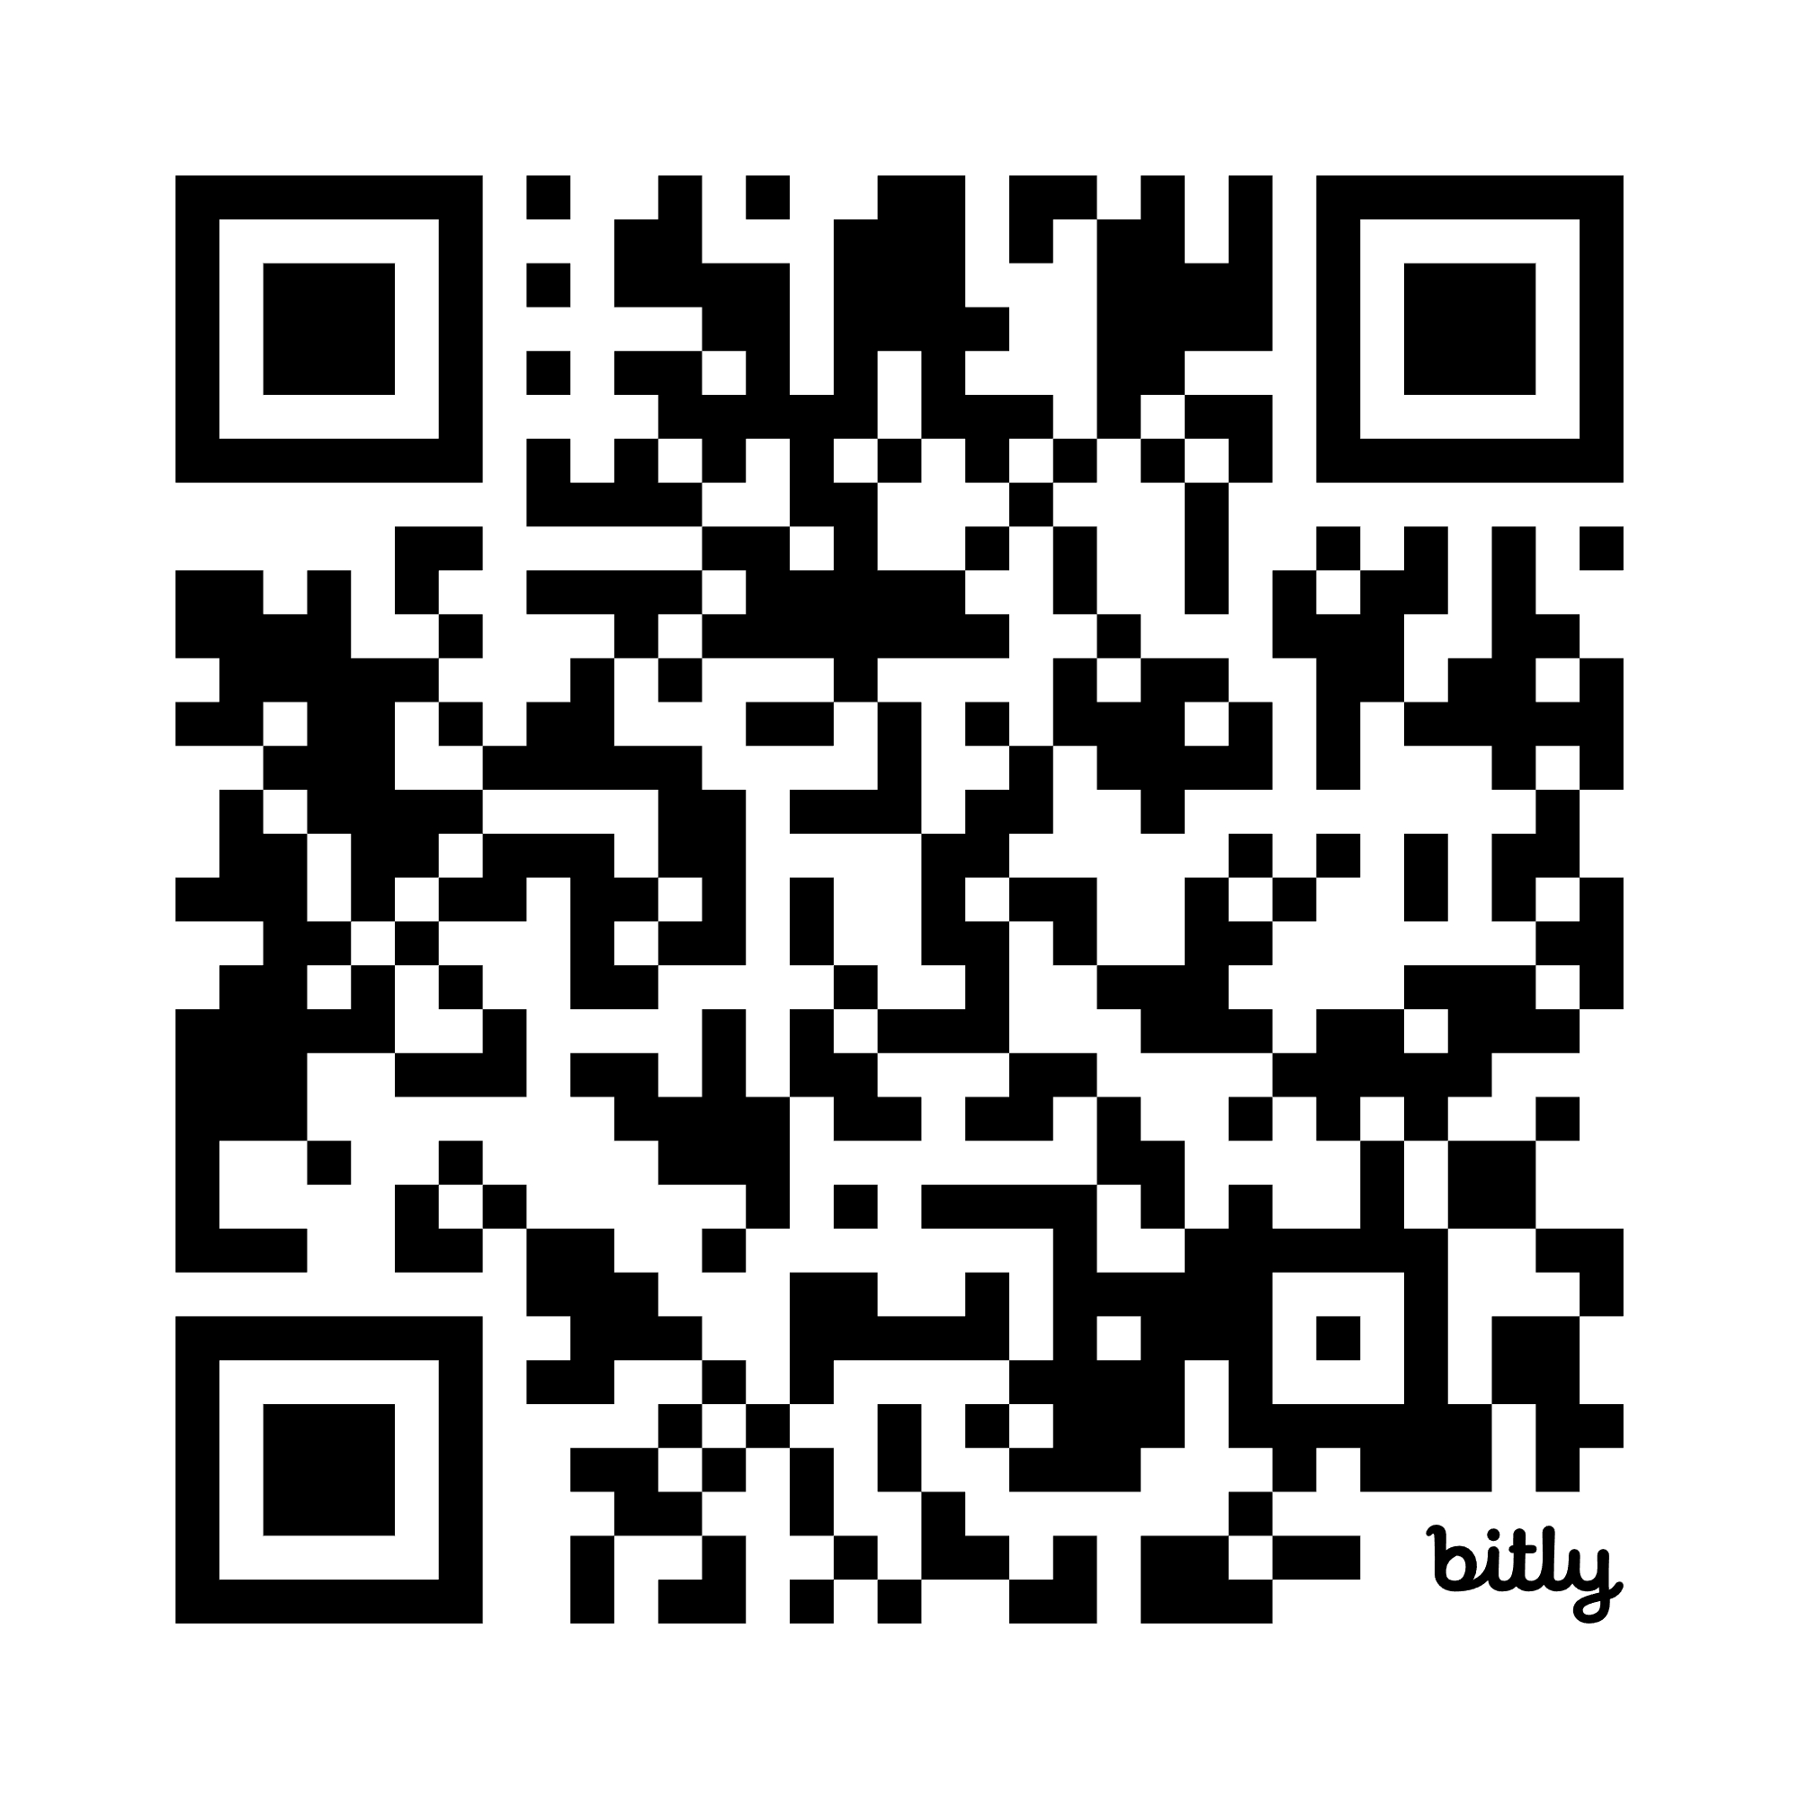
Contact: info@100homes.org.uk Social Media: @100HomesNotts Website: www.100homes.org.uk please sign up today!

